Slide 1
Capstone Project Exploring the role of Epigenetic-Age in Acute Myeloid Leukemia (AML).
Presenter
Yong Jun (Tony) Go
Supervisor
Dr Lewis E Tomalin, PhD
Notes:
Good morning everyone, my name is Tony, today I'm going to be talking about "title".

Slide 2
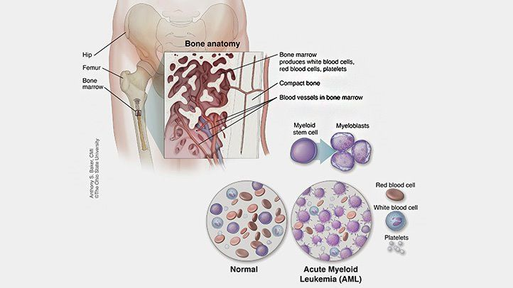
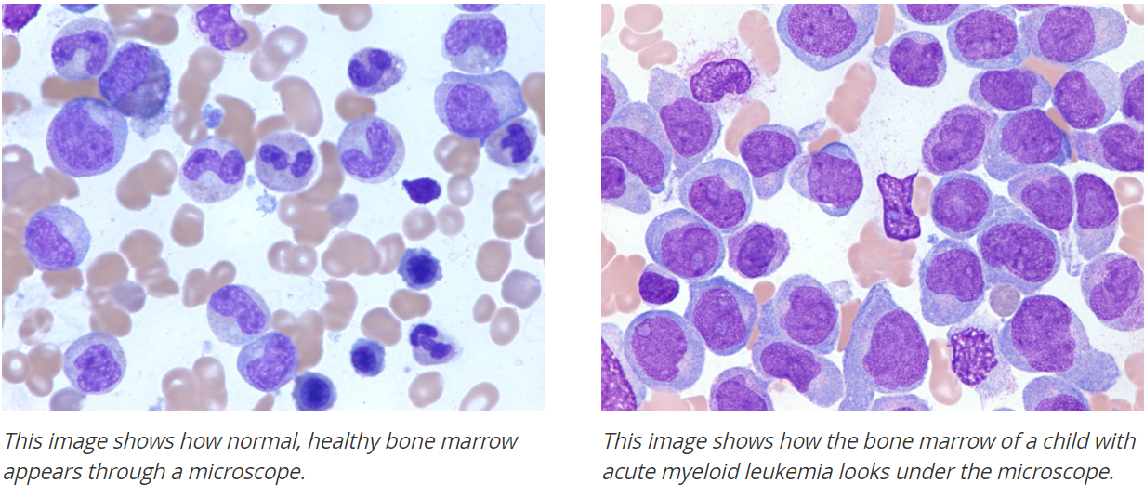
Acute Myeloid Leukemia: Bone Marrow Cancer
Notes:
The Disease we were interested in was Acute Myeloid Leukemia, or AML for short.
AML is the most common form of bone marrow cancer and is characterized by the existence of myeloblasts.
Myeloblasts are cancerous immune cells that originate from myeloid stem cells.
In people with AML, the Myeloblasts proliferate uncontrollably and crowd out the healthy immune cells, eventually, causing patients to die of infection, exessive bleeding or multiple organ failure.
*Here is microscope image from blood from a healthy patient and here is a microscope image from an AML patient. We see in AML patients they have these large purple cells. These are the myeloblasts.

Slide 3
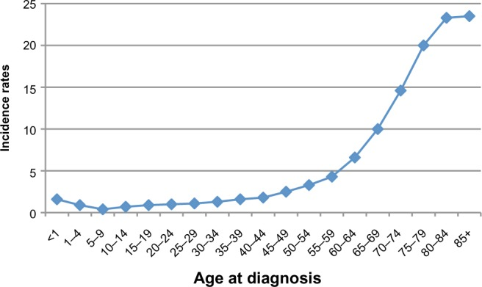
AML is an age-dependent disease
Notes:
Llike most cancers AML is an age-dependent disease. Incidence of AML is very low for people under the age of 50, but rapidly increases as patients age. For patients over the age of 85, incidence rate is close to 25%. One aspect of aging that is getting more attention is the effect of age and epigenetic alterations.

Slide 4
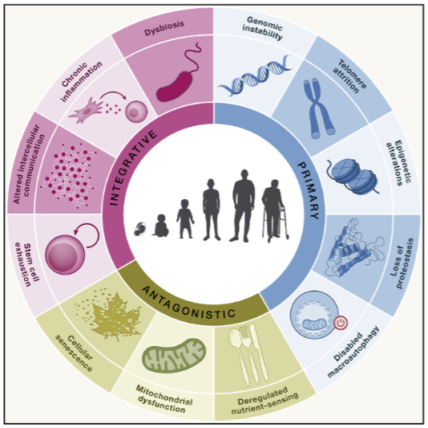
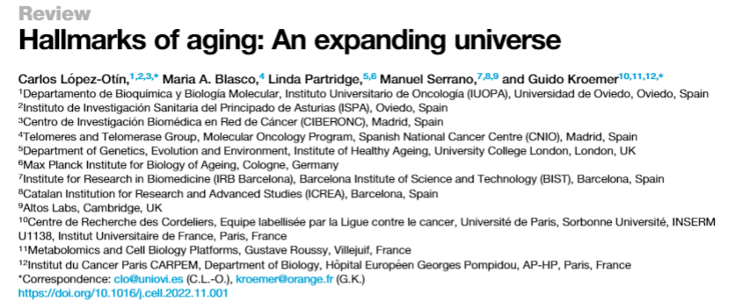
Aging Biomarkers
Lopez et. al
Notes:
When studying age-dependent diseases, it's important to understand the key hallmarks of aging. For example, epigenetic alterations are a well-established hallmark of aging. Some other examples are increased cellular senescence and chronic inflammation. If you'd like to know more about the hallmarks of aging, this recent review provides a good summary on the topic.

Slide 5
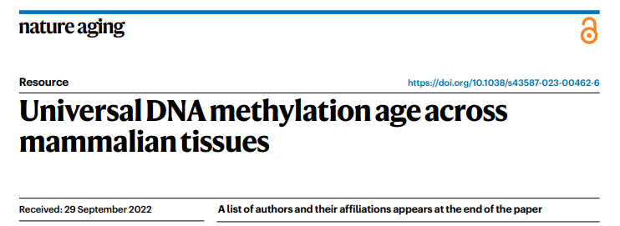
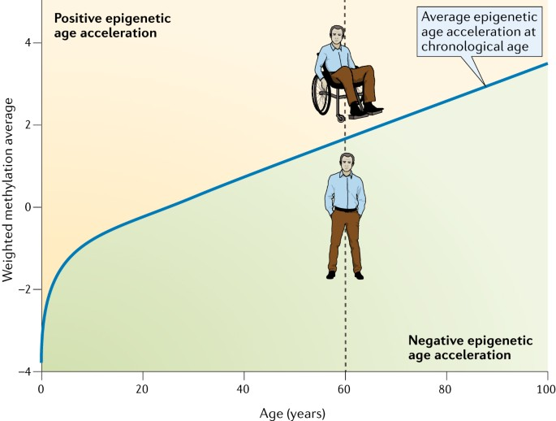
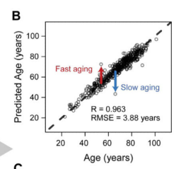
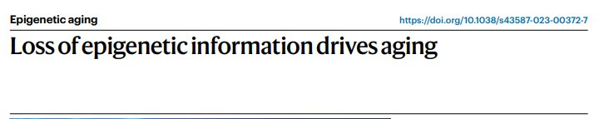
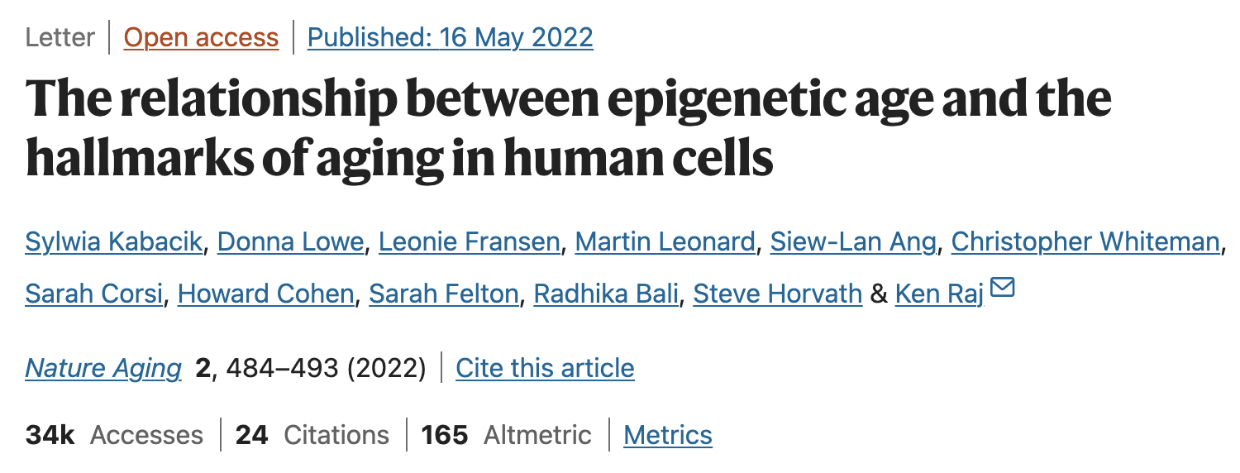
Epigenetic Clocks are biomarkers of Aging
Epigenetic Clocks estimate a person's Biological/Epigenetic Age.
If Epigenetic Age is greater than chronological age, this is called Epigenetic Age Acceleration (EAA).
EAA has been shown to be associated with age-dependent diseases such as cancer, cardiovascular disease and Alzheimers
Notes:
Epigenetic Clocks are well-established biomarkers of aging. They are machine-learning algorithms that attempt to predict a patients biological/epigenetic age based on their DNA methylation profile. Patients with an Epigenetic Age greater than their chronological age (>) are defined as having epigenetic age acceleration (EAA). It’s been repeatedly demonstrated that patients with EAA are at higher risk of all-cause mortality, including age-dependent diseases such as cancer, cardiovascular disease and Alzheimers. In our study, we'll test the hypothesis that increased EAA is associated with decreased survival in AML patients. We believe this is a reasonable hypothesis given the age-dependent nature of AML.

Slide 6
Epigenetic Clocks are biomarkers of Aging
Aim: Test the hypothesis that increased EAA is associated with decreased survival in AML patients.
Notes:
Here's the slide with our aim
Just in case: DNA methylation profile can be used to predict a person’s Epigenetic Age. Epigenetic Age is a better predictor of overall health than chronological age. We will be using the GrimAge Clock as it is ideal, and arguably the best, when analyzing human blood.

Slide 7
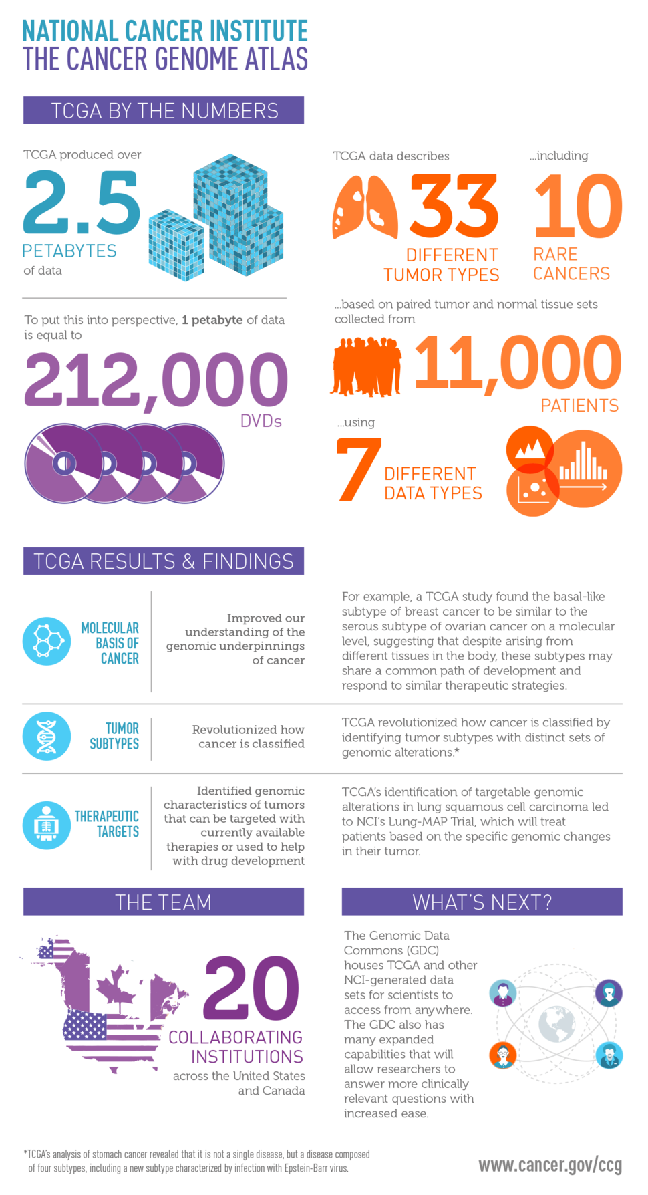
Methods
Methods: The Cancer Genome Atlas (TCGA)
Landmark cancer genomics program
Publicly available database
Generated over 2.5 petabytes of genomic, epigenomic, transcriptomic, and proteomic data.
Molecularly categorized over 20,000 primary cancer
Notes:
In order to test our hypothesis, we looked for datasets in the cancer genome atlas (TCGA). The TCGA is a landmark genomics program housing a publicly available database regarding genomic, epigenomic, transcriptomic and proteomic data. It therefore provides an excellent resource for studying the role of epigenetics in AML.

Slide 8
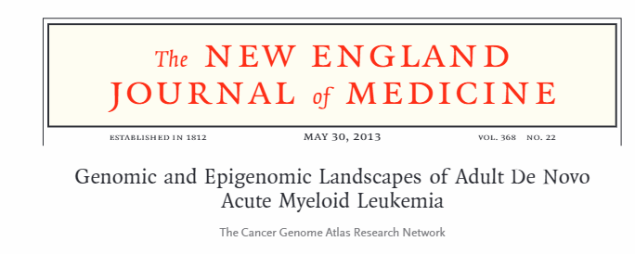
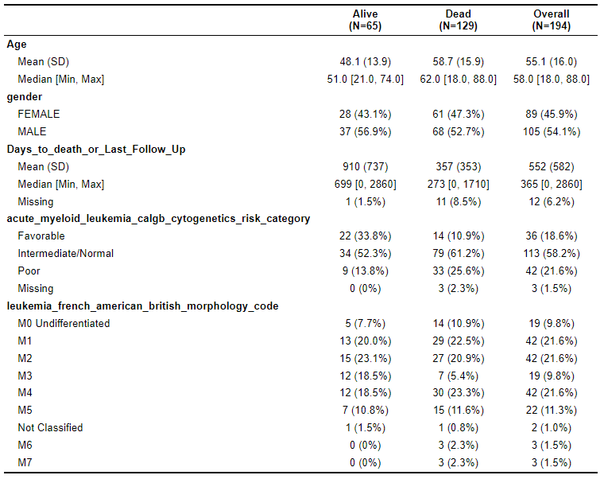
Methods
Timothy J Ley, et al.
The paper measured genetic, epigenetic and transcriptomic data in around ~200 patients.
Recorded clinical information such as vital status, leukemia morphology, cytogenic risk score.
Notes:
*In the TCGA we found *this study* that looks at around 200 AML patients and characterizes their transcriptomic, epigenetic, and genetic landscape. The measurements were all made in peripheral blood. The paper recorded clinical information such as vital status, leukemia morphology, and cytogenic risk score. Most importantly, this dataset has methylation data for each patient which allows us to estimate epigenetic age in these patients. Here is a table summarizing some important characteristics of this patient cohort. Average Age was around 55 years old. As you can see, 65 patients were still alive by the end of the study, and during the study period 129 died. It seems those that died tended to be older and average time until death was around a year.

Slide 9
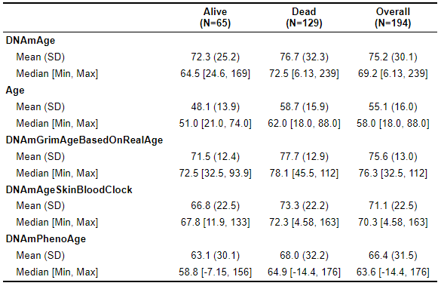

Results
https://clockfoundation.org/
Notes:
Using the DNAm age calculation tool, from the Epigenetic Clock foundation, we estimated the epigenetic age of this patient cohort based on their DNA methylation profile. This online tool estimates epigenetic age based on several different epigenetic clocks which were developed to capture different aspects of aging.
For example, the DNA methylation age clock predicts 72 patients alive and 76 dead. A scatterplot between Real age and epigenetic age can help demonstrate EAA.
We estimated several epigenetic clocks and this scatterplot shows one example.

Slide 10

Results
Notes:
Patients above the origin line experienced EAA. This patient here circled in red has a real age around 50 but a epigenetic age of around 80. The patient circled in blue would not be experiencing EAA as they lie below the line. Their real age is around 50 while their epigenetic age is around 35.

Slide 11
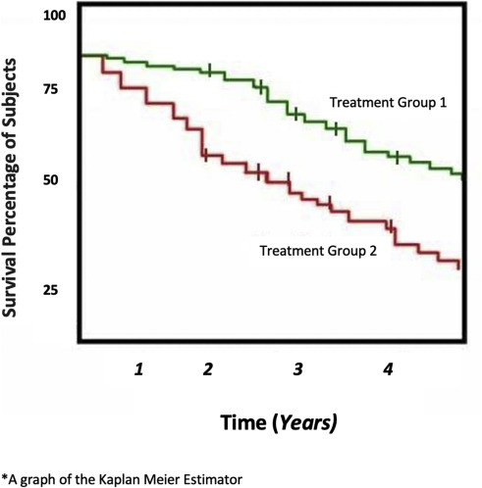
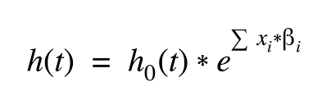
Cox Regression Model
Non-parametric Portion: h0(t) represents baseline hazard function. It is left unspecified and estimated from the data.​
Parametric Portion: exp(Sum(Xi*Bi)) represents our covariates (Xi) and (Bi).​
Notes:
To test if any of the epigenetic age metrics are associated with survival in AML patients, we performed a univariate Survival Analysis where cox Regression models.
A cox regression model or a proportional hazards model is used in Survival Analysis to analyze the time until an event, such as death. What's nice about the cox regression model is that it is semi-parametric, which, as the name implies, is somewhere between parametric and nonparametric. A parametric model is a model where the outcome is assumed to follow some known distribution. Where as a nonparametric model does not assume an underlying distribution. For example the Kaplan-Meier estimator. On the right, we see an example of a Kaplan Meier Curve. It is non-parametric because the curve is purely data-driven. It doesn't assume any specific distribution like the parametric models. The Cox PH Model includes both a parametric part and a nonparametric part.
The parametric portion comes in the form of exp(sumxi*Bi). We see here that when we fit a cox regression model, we are trying to estimate the coefficients (Bi), for our covariates (Xis). The Xis are a vector of covariates such as age and sex and the Bi is a vector of the coefficients, which represents the log of the hazard ratio. Parameters for the cox regression model are estimated using partial likelihood maximization. The nonparametric portion comes from the fact that the Cox Regression model doesn't assume a specific distribution or form for the baseline hazard function. The baseline hazard function [h0(t)] is left unspecified and estimated nonparametrically from the data.

Slide 12
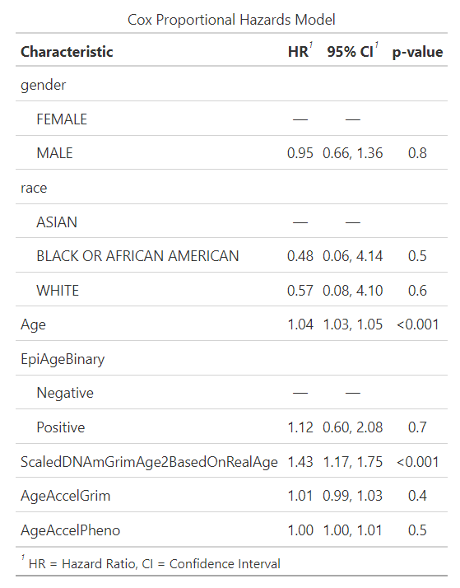
Results pt2
Univariate Analysis (49 variables in total)
Goal: Find significant/borderline variables and find covariates (p < 0.1)
Some continuous variables were scaled
Epigenetic Age Acceleration WAS NOT significantly associated with survival
13 variables were significantly associated with survival.
Notes:
To test if any of the epigenetic age metrics were associated with survival in AML patients, we performed a univariate Survival Analysis where we fit a separate univariate cox Regression model for each Epigenetic Clock, as well as for other clinical variables that may influence survival, such as white blood cell counts and the AML morphology code. Our univariate analysis tested 49 variables in total… Some continuous variables were scaled to aid in the interpreation of Hazard Ratios.
The goal was to see which variables have a significant association with survival, based on a p-value < 0.1, which could then be included in a final multivariate cox model.
The table highlights some of the variables that we were most interested in. Unfortunately, epigenetic age acceleration was not significantly associated with survival, for example the GrimAge clock and PhenoAge clock shown here had a p-value of .4 and .5 respectively.
However, 13 of the variables tested in our univariate analysis showed a significant association with survival.
#We do this to find covariates that may be biasing our analysis with just Epigenetic Age. Its possible there are other variables that are biasing/influencing our results.
*In our original univariate analysis, there were many variables with significant p-values, but hazard ratios of 1.0. We decided to scale the variables and found that the hazard ratios differed.

Slide 13
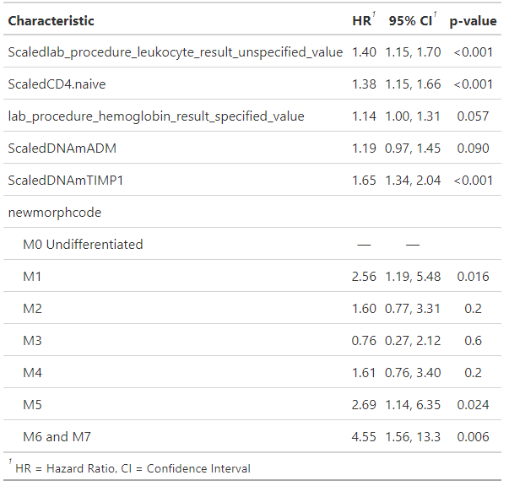
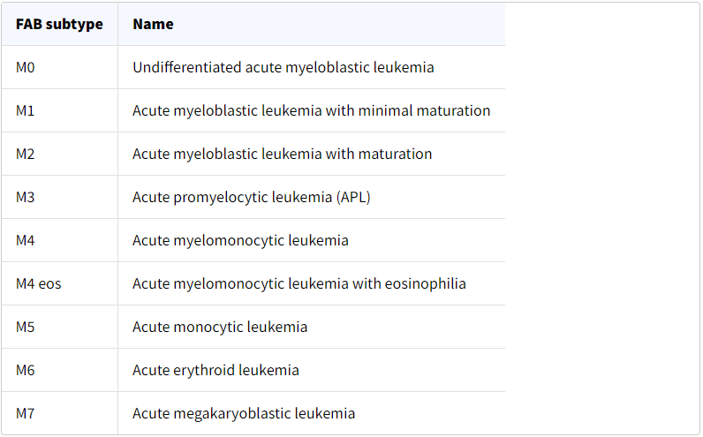
Results Part 3
Notes:
We ran a final multivariate Cox Model using the 13 significant variables from the univariate analysis, and used backward selection to select the most parsimonious model.
The final model selected included 6 variables and highlighted some interesting associations.
For example, patients with increased levels of naïve CD4 cell have increased risk. We see here that if Cd.4 is higher by one SD, your risk of death increased by 1.38.
It seems patients with the M1 morphology code, which indicates that the patient has Acute myeloblastic leukemia with minimal maturation have a 2.56 fold increase of death than those with Undifferentiated acute myeloblastic leukemia.
Interestingly, an epigenetic clock that estimates the expression of the TIMP1 biomarker showed a significant association with survival, as we can see from the table, if a patient has a higher level of TIMP1 by one SD, their risk of death increases by 65%…..

Slide 14
Results Part 4
Notes:
To try to visualize these results, we made Survival curves for Cd4.naive cells and TIMP1 expression categorized into tertiles. The hazard ratio for CD.4 was 1.38, and we see that those with lower levels of CD.4 naïve cells had higher Survival than those with higher levels. The hazard ratio for DNAmTIMP1 was 1.65 and we see that those with lower levels of DNAmTIMP1 had higher survival than those with higher levels.

Slide 15
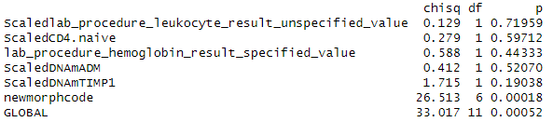
Proportional Hazards Assumption, Schoenfeld Residuals
H0: If p-value is <0.05, the PH hazards assumption is not met
HA: If p-value is ≥ 0.05, the PH hazards assumption is met
Notes:
One important thing to note about the Cox Regression Model is that it assumes that the hazard ratios between individuals are constant over time, which we refer to as the proportional hazards assumption. The PH assumption can be tested with the Schofield Residuals. The Null hypothesis would be the PH hazards assumption is not met, meaning we would want to fail to reject if we want the PH assumptions to hold. We found that while most of the significant variables from the univariate analysis fulfilled the assumptions, morphology code did not. In order to remedy the violation of the PH assumptions, we could include time-dependent covariates by introducing an interaction term between morphology code and time to event. Alternatively, we could have stratified the cox ph model by morphology code so the baseline hazard function varies between strata. Due to time constraints, we were unable to do this but it's an important limitation that we should bring up.

Slide 16
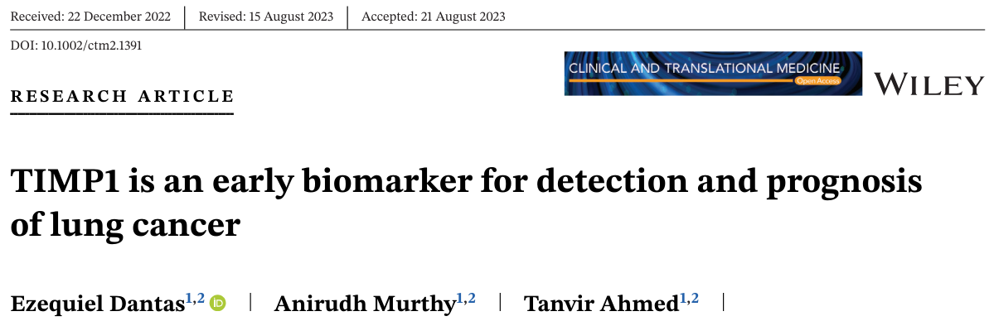
Conclusions
Epigenetic Age Acceleration is not significantly associated with Survival in AML patients.
An epigenetic clock that estimates TIMP1 expression indicates that higher levels of TIMP1 are associated with worse survival.
TIMP1 is a protein involved in regulating cellular proliferation.
Interestingly, a recent study has highlighted TIMP1 is a potential biomarker for detection and prognosis of Lung Cancer. Perhaps it could also have a prognostic role in AML
Notes:
For our conclusion, we found that Epigenetic Age Acceleration was not significantly associated with Survival in AML patients. An epigenetic clock that estimates TIMP1 expression indicated that higher levels of TIMP1 were associated with worse survival. TIMP1 is a protein involved in regulating cellular proliferation. Interestingly, a recent study has highlighted TIMP1 as a potential biomarker for detection and prognosis of Lung Cancer. Perhaps it could also have a prognostic role in AML.

Slide 17
Thank you. Questions?
Presenter
Yong Jun (Tony) Go
Supervisor
Dr Lewis E Tomalin, PhD
Notes:
I'd like to thank my supervisor, Dr. Lewis Tomalin, for his guidance during this project and I'd like to thank everyone here for making the time to be here. Are there any questions?

Slide 18
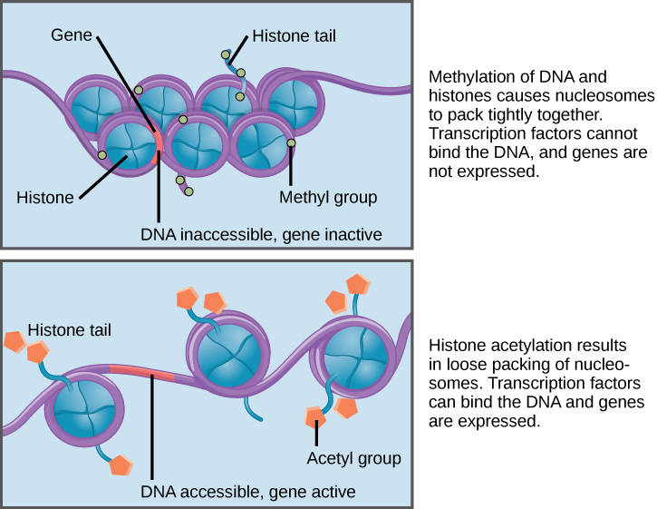
What is Epigenetics?
Notes:
*keep just in case

